Slide 1
Approaches to Implementing the Nonclinical Common Templates in Your Organization
February 2022

Slide 2
What can the Templates Offer Organizations?
IMPROVE EFFICIENCY
Decrease time spent looking for key content by aligning format which can decrease study errors and improve data quality
Leads to more rapid protocol development
IMPROVE QUALITY
Reduces multiple report formats across organizations, resulting in more efficient report authoring and reviews by CROs, Sponsors, and regulators
Spend less time on low-value customization and reduce time managing template maintenance
FACILITATE COMPLIANCE
Consistent format across protocols simplifies the QC check of the SEND package

Slide 3
Guiding Principles for Implementation
The materials can be used in a highly flexible manner, as reflected in the guiding principles on the next slide
i
The Implementation Materials are:
High level roadmap designed to support implementation of the Nonclinical Common Protocol Template (NCPT) and Nonclinical Common Report Template (NCRT) across project management, people, process & technology
Designed to assist in communicating the initiative to various audiences
Available to any Company or Organization who chooses to implement
… but are not:
A detailed step-by-step workplan
Activities that must be followed exactly, including company or sponsor-specific documentation

Slide 4
Guiding Principles for Implementation
Each BioCelerate member company or non-member organization is free to decide and must decide for itself whether and in what manner to adopt the NCPT and/or NCRT
These materials are intended to help those companies or organizations who decide to adopt the NCPT and/or NCRT
Implementation components are generic and may need to be tailored to an organization prior to use
While BioCelerate member companies or non-member organizations have absolute discretion to implement BioCelerate solutions as they see fit, changing certain NCPT or NCRT components will likely reduce some of the efficiencies for sites, investigators, and sponsors
It is up to each BioCelerate member company or non-member company to define further the detailed steps for each implementation strategy within their respective organization

Slide 5
Your Organization’s Route to Template Adoption
Recognize that change can be difficult, and each organization is unique
It is important to have conversations with internal and external stakeholders to assess impact and an adoption path that ensures the best outcome for your organization
Organizations choose their own path to adoption
By phases that include:
Team/Leadership Conversations and Alignment
Company/Sponsor Conversations
Mapping Exercises (see Mapping Tool document)
Possible roll-out options include
Slowly: introduce through pilots(s), then expand more broadly
All-in: Target a cut-over date for universal use
Somewhere in between: Introduction through non-GLP studies and
then target a cut-over date to GLP studies

Slide 6
Assessing the Impact: Practical Considerations
An internal assessment that includes impact to culture, philosophy and practical application
Scope of change
Viability of change
Flexibility of your organization to accept NCPT suggested wording and NCRT layout
Resource & Technology impact – internal and external
Transparency of challenges (perceived or actual)
What needs to be mitigated for initial implementation vs. longer term updates to SOPs
Communication/Integration plans
Identifying a pilot or test study
Utilize the Mapping Tool as a first step
available for download on the BioCelerate website within ‘Available Assets’

Slide 7
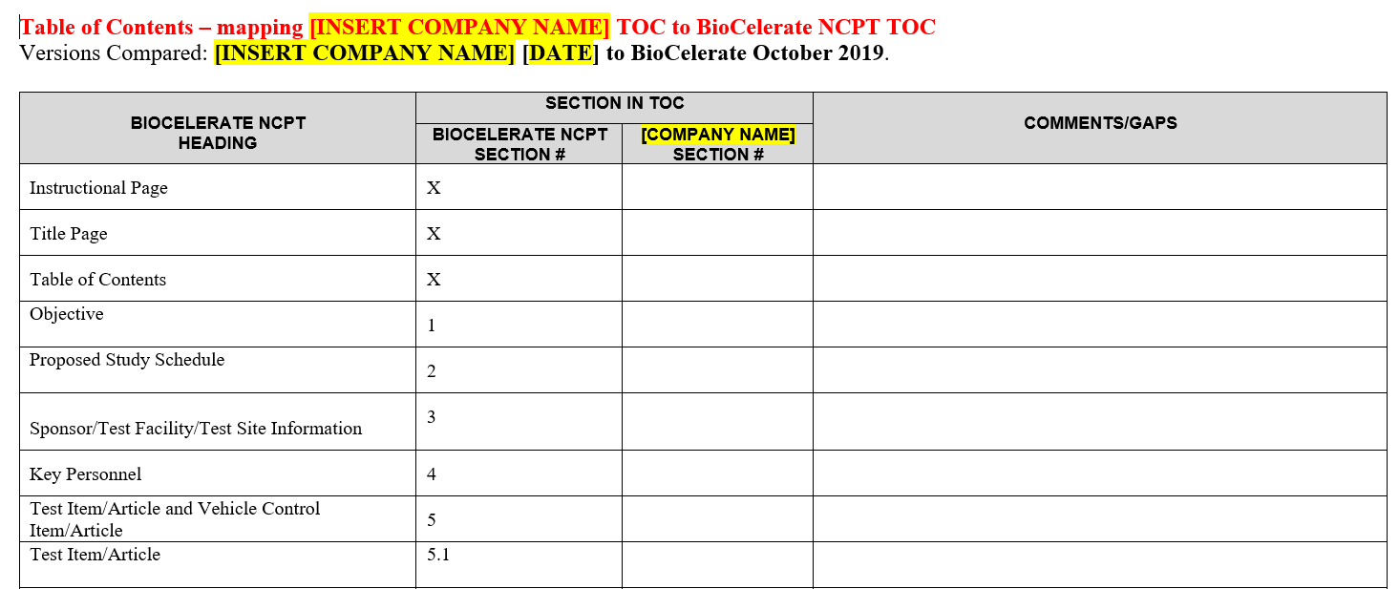
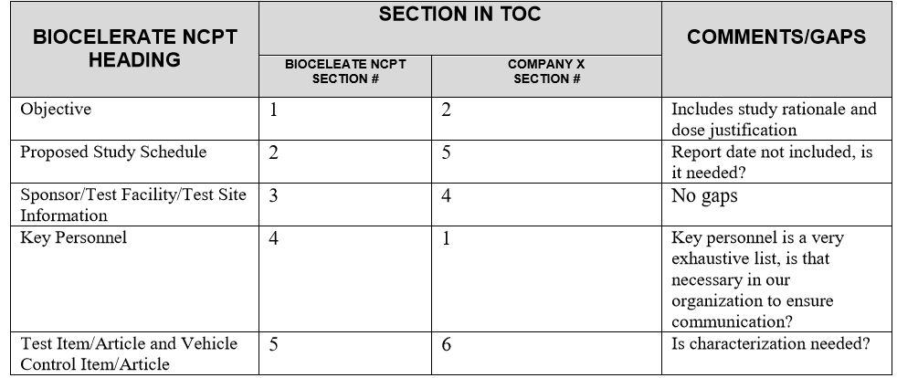
Assessing the Impact: Using the Mapping Tool to assist in highlighting impacts and risks of adopting the NCPT
Download the Mapping Tool and Mapping Tool Instructions from the BioCelerate website
Download V1.1 NCPT from the BioCelerate website
Choose your organization’s Protocol Template for comparison in the exercise
Complete the Mapping Table Exercise
Identify content used in a company/sponsor template that is not included in the NCPT
Identify differences in wording of same topics in company/sponsor template vs NCPT
Identify if information is found elsewhere in SOPs, etc.
Mapping Tool Example

Slide 8
Assessing the Impact: Report Template (NCRT)
Key Components to Consider
Determine a strategy to enable inclusion of the protocol within the study reports, i.e., links
Understand which sections of contributor reports are mapped to reference or populate the content of the main report
Guidance for integration to ensure internal and external stakeholders are aligned
Leverage adoption of the NCPT to streamline the NCRT
Download
V1.1 Nonclinical Common Report Template from the BioCelerate website
Copyright ©2020 BioCelerate., All rights reserved.

Slide 9
Sharing the Results of Initial Impact Assessment
Each Organization to tailor this slide to their specific analysis results
<< Insert Organization Specific Details >>
Share key results of Alignment Conversations, Answers to Impact Questions and Mapping Tool Exercise
Share downstream impacts of content
Propose mitigation for content not aligned with the template
Propose next steps

Slide 10
Thank You for more information visit www.biocelerate.org
Copyright ©2020 BioCelerate., All rights reserved.

